Slide 1
Information Technology FIT3143 Parallel Computing Semester 2 2024
Week 6:
Workshop 06
Dr Terrence Mak
Faculty of Information Technology
© 2024 Monash University

Slide 2
Agenda
Workshop 6
Cluster Performance
Cluster Hardware and Fabrics

Slide 3
Cluster Performance

Slide 4
Benchmarking the Cluster
How do we know how fast the cluster runs?
Measurement of performance is an important factor while selecting a system design and architecture
Numerous methods exist for benchmarking a cluster – none are ideal
Important that the technique used provides a representative compute load compared to the intended application;
Workloads can be homogenous – e.g. parallel identical jobs – clusters, grids;
Workloads can be inhomogeneous/hetergenous – parallel but very different jobs – clouds;

Slide 5
Network Latency and Bandwidth
Latency is easy to determine by measurement of elapsed time using common clocks;
Bandwidth (throughput, capacity) is easy to determine by benchmarking;
Results must be used with caution, as time variant network conditions dictate latency and usable bandwidth at any time;
Latency and bandwidth only characterise the network and not the computational aspects of the system;
Measurements usually done on lightly loaded systems to determine best achievable performance;
Many tools available for latency and bandwidth measurements
Some lab tasks will provide opportunity to do measurements

Slide 6
Computational Performance
How much computational effort a cluster can do determines its economic viability and usefulness
Performance is a measure of computational effort done per time under some set of conditions
Computational effort is the quantity or number of computational operations e.g. machine instructions performed
Performance metrics are usually highly sensitive to the conditions of measurement – e.g. type of workload, application program, operating system, and configuration of the hardware platform

Slide 7
Computational Benchmarking
The performance of a computer is usually measured by benchmarking
Benchmarking can be done by running a specific application and measuring how long it takes to run and what compute resources are consumed
Benchmarking can also be done by running a dedicated benchmark applications or benchmark suites
In all benchmarking we seek “like comparisons”, as in “comparing apples to apples, rather than apples to oranges”
The intent is always to perform measurements of performance that permit honest side by side comparisons between systems
Vendors have a long running history of manipulating benchmarks to favour their products – caveat emptor applies!

Slide 8
Performance Metrics – FLOPS/MOPS/MIPS
Maximum aggregate performance of the system can be measured in terms of Maximum aggregate floating-point operations:
P = N*C*F*R
Where:
P performance in FLOPS, MFLOPS, GFLOPS,
N number of nodes,
C number of CPUs (CPU cores),
F floating point operations per clock period,
R clock rate.
The other measure is for integer operations – using MOPS/MIPS where P is expressed in integer Mega- “Operations” or “Instructions”

Slide 9
Application Performance
Number of operations performed while executing the application, divided by the total runtime, M/GFLOPS or M/GOPS.
Computed using a program similar to the actual program the user intends to run on the production system.
More meaningful than theoretical peak performance.
Need to correctly estimate the number of floating point (or integer) operations in the code.
The algorithm must be optimised.
Problems may arise if the code was tuned for a particular platform; specifically where code includes features written around machine specific performance accelerators.

Slide 10
Application Runtime Comparison
The total “wall-clock” run time for an existing application and dataset.
It frees us from counting the operations in the code – simply compare time to compute
Also it removes the need to develop benchmarking code which may differ from the intended application.
Performance tuning could distort results
The same application must be run on all systems being benchmarked against one another under identical conditions

Slide 11
Scalability How Well Does It Scale?
One measure of Scalability is computed thus:
S = T(1) / T(N)
Where T(1) is the wall clock time for a program to run on a single processor
T(N) is the runtime over N processors
A scalability figure close to N ie S≅ N means the program scales well
Scalability metric helps estimate the optimal number of processors for an application
Amdahl’s Law and other models can be used to estimate scalability

Slide 12
Efficiency
It is calculated thus:
E = P(N)/N where P is performance
Values close to unity or 100% are ideally sought
This metric suffers from the same problems as the Scalability measure

Slide 13
Percentage of Peak
Application performance statistics are gathered in terms of the percentage of the theoretical peak performance
A real application is run and results compared to a theoretical estimate
Such statistics highlight the extent an application is making use of the computational power of the system
Depends on the type of the application and statistical mix of executed instructions

Slide 14
Q1
Given an old cluster with 10 identical nodes/machines and known to have a maximum aggregate performance of 640 GFLOPS.
Each machine contains 4 cores (processors) and 3200MHz DDR4 RAM and each core can process 8 floating point operations per clock cycle.
What is the clock cycle of a machine in the cluster in GHz?

Slide 15
Q2
Given a cluster with 50 nodes/machines.
For half of the cluster, the machines are newer and each machine contains 96 cores/processors and 3600MHz DDR4 RAM. For each of the cores/processors, the clock rate is 2.4Ghz and each core can process 16 floating point operations per clock cycle.
For the other half of the cluster, the machines are older and each machine contains 12 cores/processors and 3200MHz DDR4 RAM. For each of the cores/processors, the clock rate is 2.0Ghz and each core can process 8 floating point operations per clock cycle.
What is the maximum aggregate performance of the cluster in GFLOPS?

Slide 16
Cluster - Hardware and Fabrics

Slide 17
Clusters - Fabrics
Clusters need interconnects to carry traffic between the machines or “nodes” forming the cluster
The general term for such an interconnect is “fabric”
Fabrics are typically defined by the type of interconnect used and the type of topology used
While variants of Ethernet remain the most common interconnect used in clusters, especially small/cheap clusters, higher performing clusters use faster interconnects (below)
Topologies vary widely and reflect operator priorities – tradeoffs between performance and reliability (redundancy)
Considerations are path length, latency, fault tolerance, scalability and cost (Chkirbene et al, 2018)
Pathlength and latency impact performance, fault tolerance impacts reliability, and cost reflects complexity

Slide 18
Comparing Topologies (Chkirbene et al, 2018)
Degree of nodes: the number of ports per server in the data centre. “Flat” topologies have degree = 2, while “Recursive” topologies have degree > 2
Scalability: number of nodes in the topology, good scalability allows incremental increases to large numbers
Diameter: defined as the maximum of the shortest distances between all pairs of nodes
Fault tolerance: continues to operate even in the presence of component failures
Average Path Length: the APL shows the efficiency of the routing algorithms employed in packet transmission
Bandwidth: data transfer rate or throughput from one node to another. One-to-One, One-to-All, One-to-Several and All-to-All bandwidth often employed

Slide 19
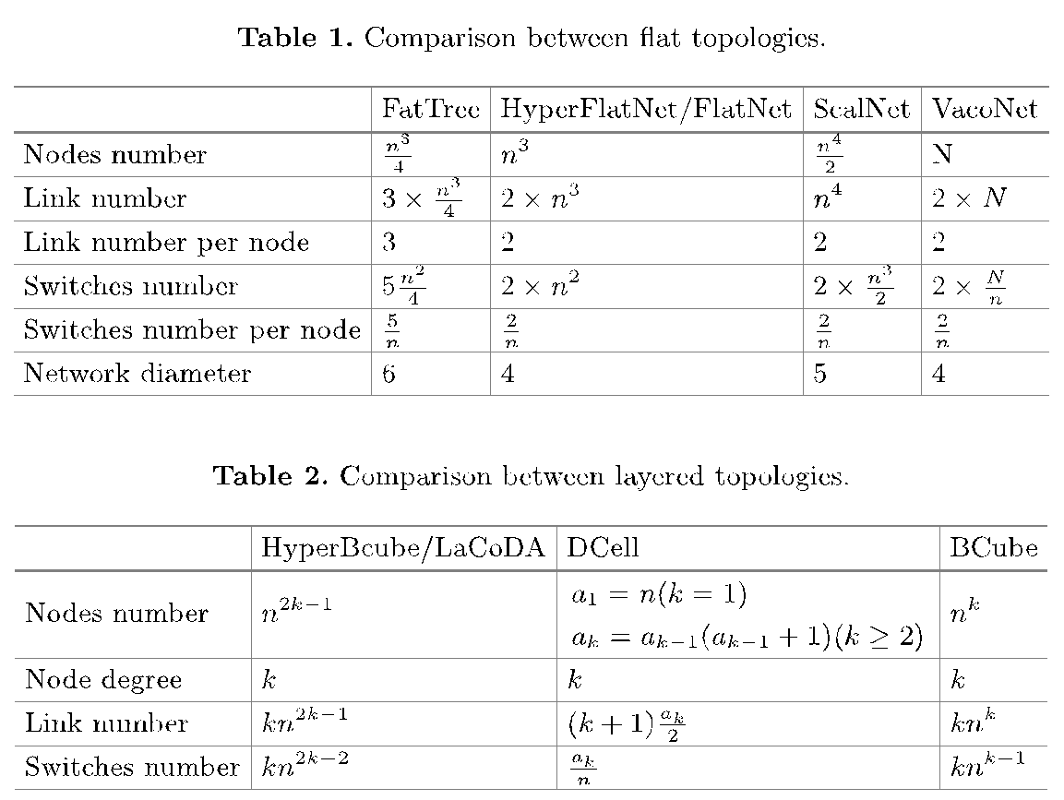
Comparing Topologies (Chkirbene et al, 2018)

Slide 20
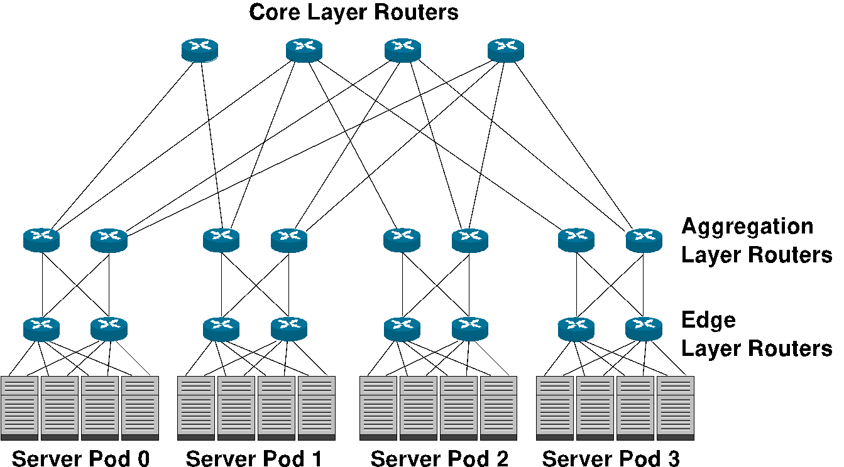
Cluster Fabric Topology Example – Fat Tree Model
Note core layer routers will be higher performing compared to aggregation and edge layer switches

Slide 21
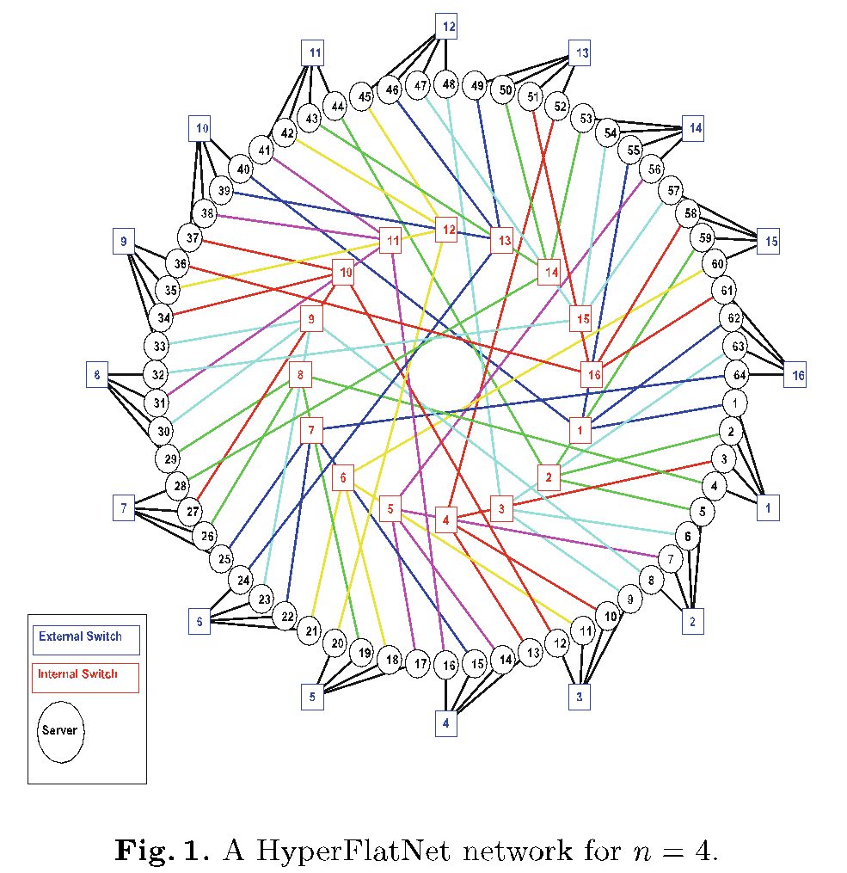
Cluster Fabric Topology Example – HyperFlatNet

Slide 22
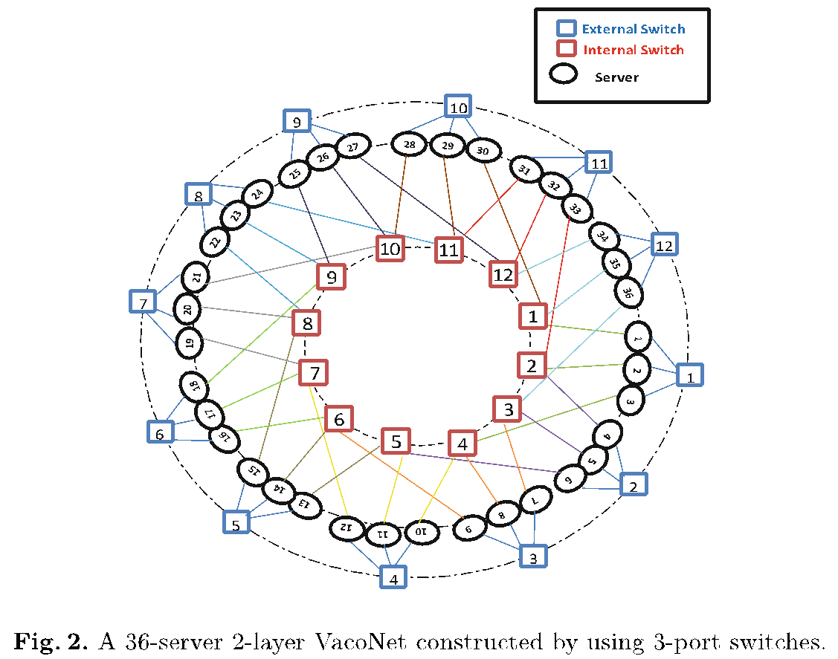
Cluster Fabric Topology Example – VacoNet

Slide 23
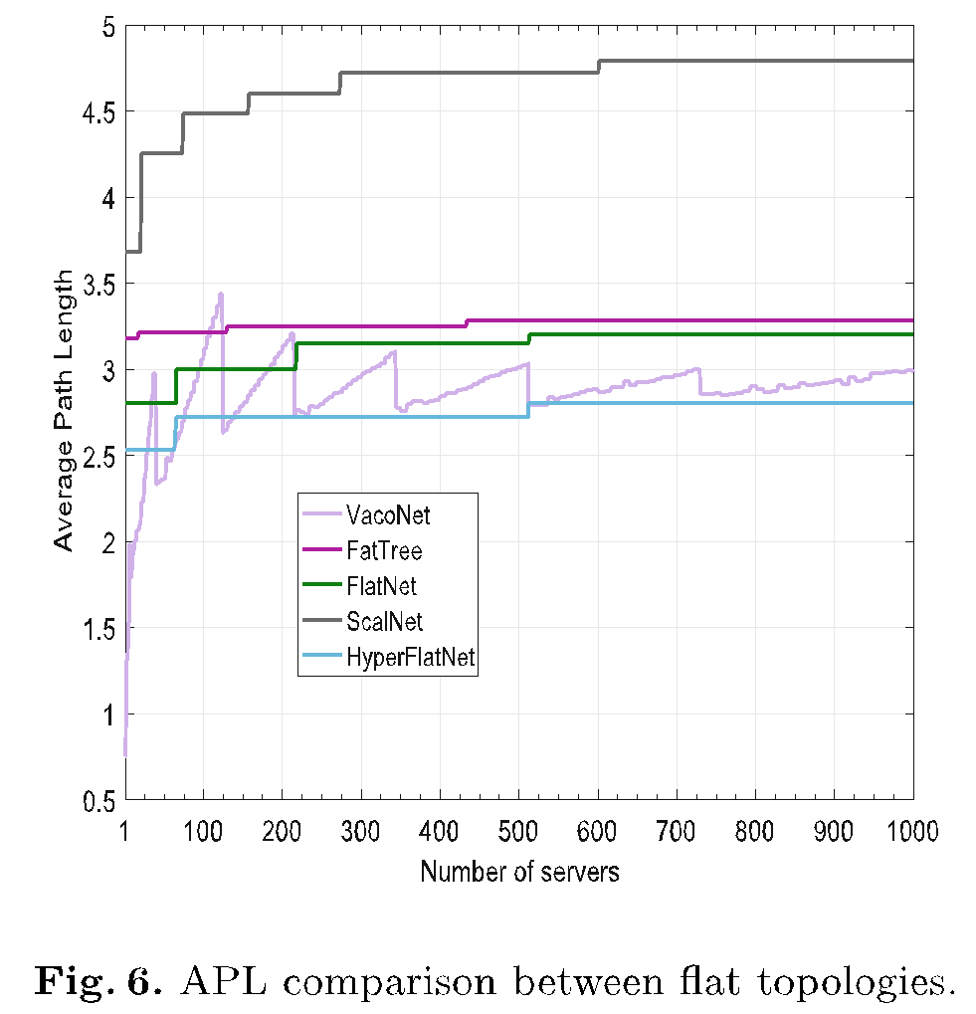
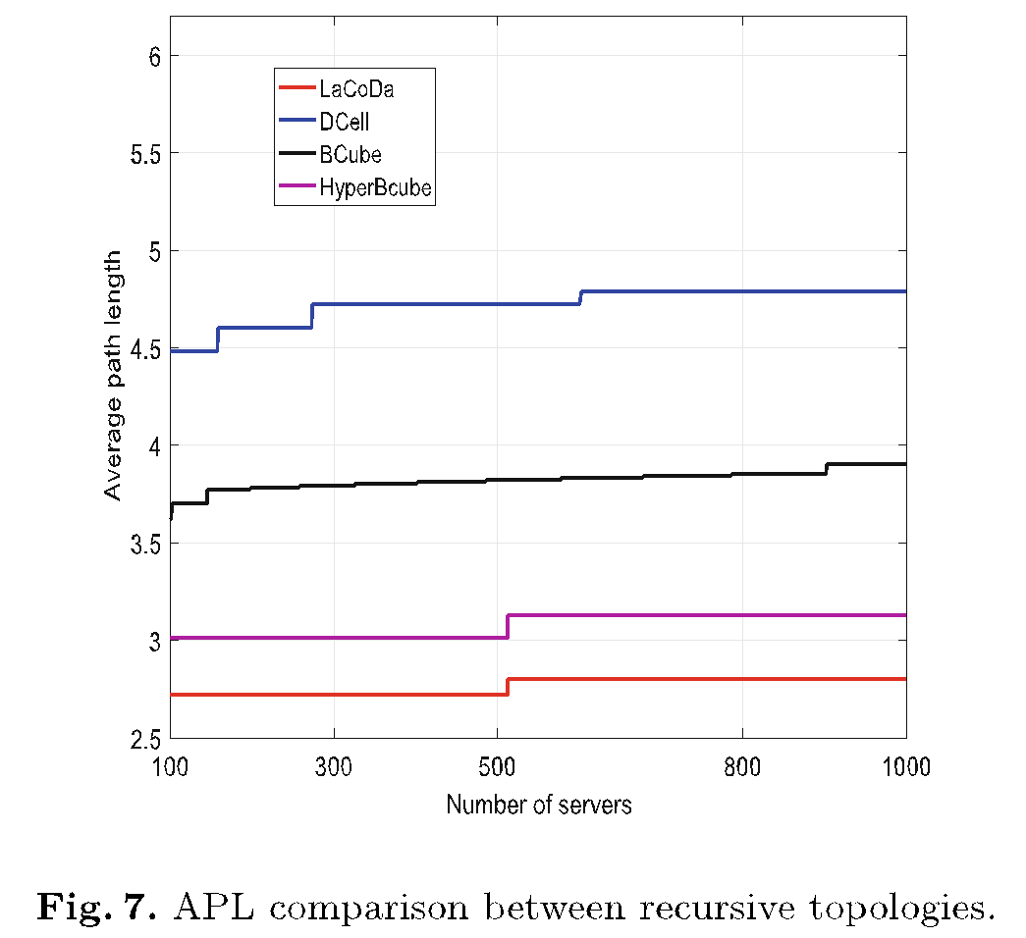
Cluster Fabric Topology Performance – Average Path Length
Lower APL is better due to lower cumulative queuing delay across routers/switches - Chkirbene et al, 2018

Slide 24
Q3
The question asks about cluster network topology.
Given a small cluster with 8 nodes/machines, connected via 1 Gbps links in a ring topology.
For each node, a 2MB MPI message will be sent periodically to all neighboring nodes every 10 seconds to announce the node is alive.
Assumption:
Transmission delay is the major factor, and we assume all the other delays (queuing delay, the processing delay, and propagation delay) between a pair of connected nodes adds up to 0.004s.
For ease of calculations, we assume 1 MB = 1,000,000 bytes, and 1 Gbps = 1,000,000,000 bits per second (bps).
Nodes receiving messages are instant and no reply messages are needed.
Which of the following statements are true?

Slide 25
Q3
To provide a better estimate on when a node is dead (not alive), we can shorten the message resending period to 0.025s.
To provide a better estimate on when a node is dead (not alive), we can shorten the message resending period to 0.01s.
To provide a better estimate on when a node is dead (not alive), we can shorten the message resending period to 0.01s if message size is decreased to 1MB.
To provide a better estimate on when a node is dead (not alive), we can shorten the message resending period to 0.01s if message size is decreased to 0.5MB.
To provide a better estimate on when a node is dead (not alive), we can shorten the message resending period to 0.017s if the other delays (queuing delay, the processing delay, and propagation delay) between a pair of connected nodes is 0.00001s.

Slide 26
Q4
The question asks about cluster network topology.
Given a small cluster with 6 nodes/machines, connected via 1 Gbps links in a certain topology.
The machine is considered fault tolerant when a 1MB message sending from a node can be received by any other nodes in under 0.03 seconds when any 1 link is faulty (disconnected).
Assumption:
Transmission delay is the major factor, and we assume all the other delays (queuing delay, the processing delay, and propagation delay) between a pair of connected nodes is 0 seconds.
For ease of calculations, we assume 1 MB = 1,000,000 bytes, and 1 Gbps = 1,000,000,000 bits per second (bps).
Which of the following statements are true?

Slide 27
Q4
If the machines are connected in a line topology, the network is not fault tolerant.
If the machines are connected in a line topology, the network is fault tolerant if the links are upgraded to 10Gbps link.
If the machines are connected in a binary tree topology, the network is not fault tolerant.
If the machines are connected in a binary tree topology, the network is fault tolerant if the links are upgraded to 10Gbps link.
If the machines are connected in a ring topology, the network is not fault tolerant.
If the machines are connected in a ring topology, the network is fault tolerant if the links are upgraded to 10Gbps link.

Slide 28
Summary

Slide 29
Summary
Workshop 6
Cluster Performance
Cluster Hardware and Fabrics

